Slide 1
NopCommerce Website
Under Guidance of Mrs. Vaishali Sonawane Madam

Slide 2
Introduction :
nopCommerce is a popular, open-source e-commerce platform used by businesses worldwide to create online stores. It supports a wide range of features like product management, user registration, shopping cart, and secure checkout.
With so many users and transactions, it’s crucial that the website works smoothly and securely. Testing helps find and fix issues early—making sure the site is reliable, fast, and easy to use for every customer.
This project automates testing for nopCommerce to ensure all features work correctly and provide a great user experience.

Slide 3
Overview
What is nopCommerce? nopCommerce is a powerful, open-source e-commerce platform built on ASP.NET Core, enabling businesses to create and manage fully customizable online stores. It supports business-to-consumer (B2C) and business-to-business (B2B) models, offering features like product catalogs, multi-store support, secure payment processing, and mobile-responsive design.
This project focuses on testing nopCommerce’s critical functionalities—user registration, login, product search, shopping cart, checkout, and account management—to ensure a seamless, secure, and efficient experience for both merchants and customers.
Automated testing validates functionality, performance, and reliability, helping maintain high standards for a platform trusted by global users.

Slide 4
Modules
Module 1: Registration page
Checked all the functionalities in Registration page which included name, email, company, newsletter, password and submission button functionalities.
Module 2: Log in page
Checked all the functionalities on Log-in page which included email address, password, remember me and submission button functionalities.
Module 3 : Search Module
Tests if the search bar finds products, shows suggestions, and handles wrong/no inputs.
Module 4 : Cart Management
Tests adding/removing items from the cart to ensure smooth checkout.
Module 5 : Wishlist
Checks if user can add items to wishlist and move that items to cart management
Notes:
Module 1: Signn in page
Checked all the functionalities on Sign in page which included personal info as email
address, password
Module 2: Women page
Checked all the functionalities on Women page which included item details, Quantity, Filters,compare button,Add to cart button,product info,grid,list button
Module 3: Tshirt page
Checked all the functionalities on T-Shirt page which included item details, Quantity, Filters,compare button,Add to cart button,product info,grid,list button
Module 4: All Buttons and Drop Down Arrow :
team checked if all the buttons and drop down arrows of different fields are functioning properly or not

Slide 5
Module 6 : Orders
Tests if all the orders of a particular user account is correctly displayed or not
Module 7 : User Address
Tests changing/editing existing addresses of the user
Module 8 : Social media
Verifies if the social media buttons at the bottom is working properly or not
Module 9 : News
Checks if the news in the news section is properly displayed or not and either we can add or view comments
Module 10 : Checkout
Tests if the checkout function after adding to cart is working properly or not

Slide 6
Defects
While running a testcase at certain point some fields are not working as it is expected which is nothing but a defect, so I have created a Defect report on those defects.

Slide 7
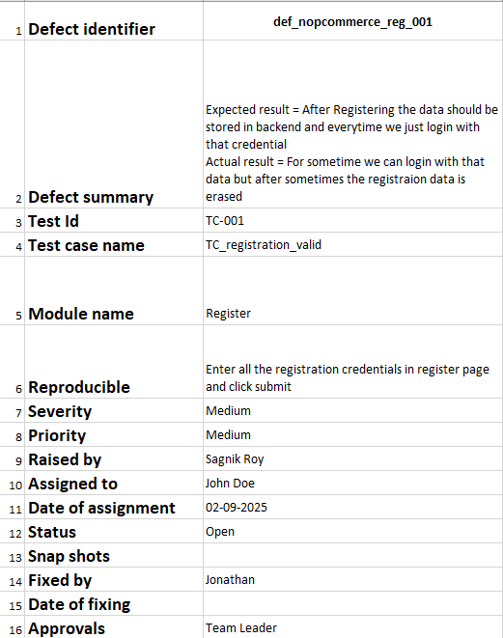

Slide 8
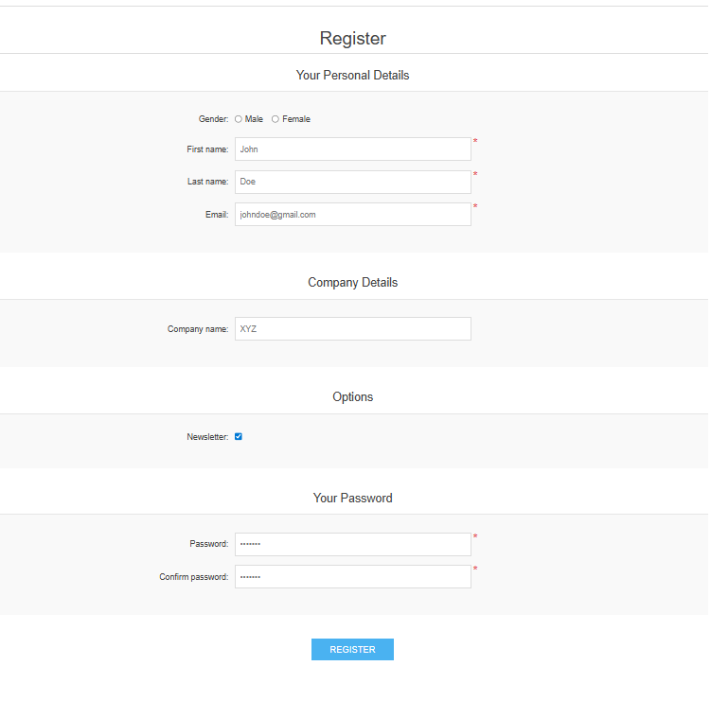
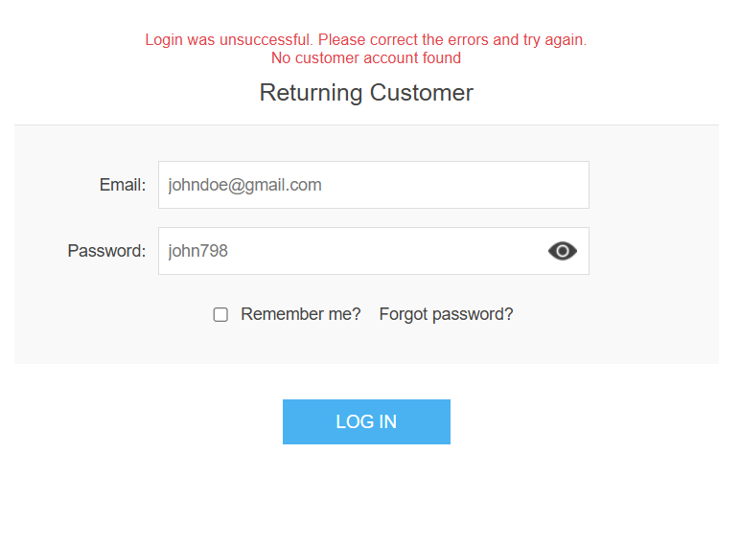
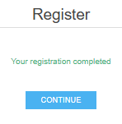
LOGIN PAGE

Slide 9
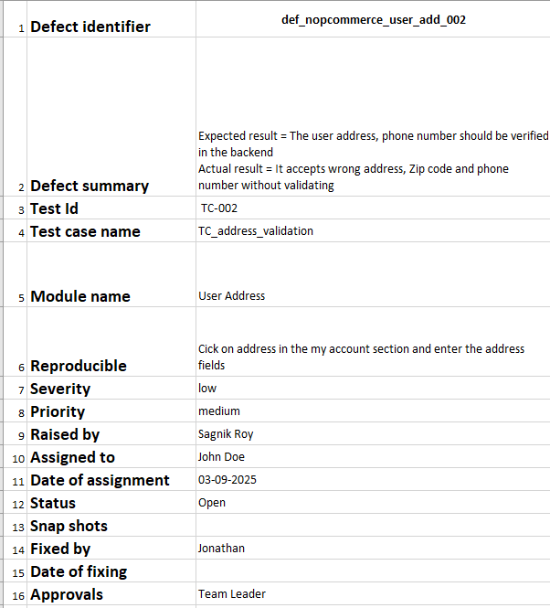

Slide 10
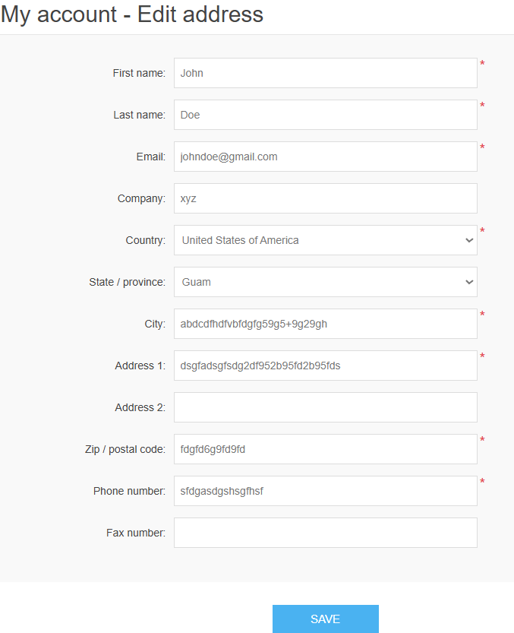
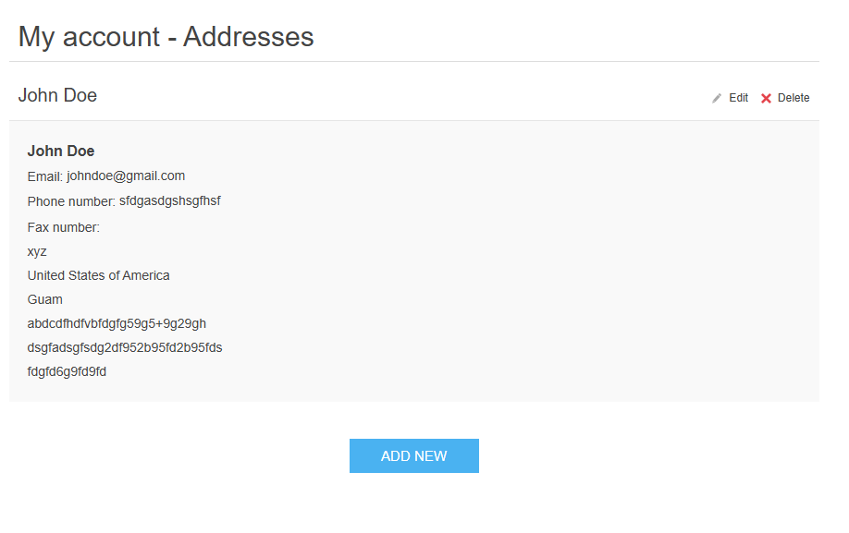

Slide 11
Challenges
Dynamic & Customizable Platform: nopCommerce is highly customizable with plugins and themes. Frequent updates or changes to these elements can break existing UI automation scripts, requiring constant test maintenance.
Network & Performance Fluctuations: The admin panel and storefront can behave slowly during data-intensive operations (e.g., generating reports, importing products). This causes tests to fail due to elements loading slower than the script's wait time, requiring robust and intelligent synchronization.
Handling High Traffic & Load: During sales or promotions, the server response time can increase dramatically. Standard functional UI tests are not reliable in this state, as failures may be due to performance issues rather than actual bugs, skewing test results.

Slide 12
Experience
Testing a live nopCommerce store provided real-world experience far beyond textbook examples, specifically in handling:
Customized Functionality: Testing unique workflows built with custom plugins and themes.
Complex Data Flows: Managing intricate user journeys across the front-end store, admin panel, and third-party integrations (e.g., payment gateways, shipping calculators).
Multi-Environment Validation: Ensuring consistency across staging and production environments after updates.
The pros? I gained hands-on experience in end-to-end (E2E) regression testing, sharpened my skills in identifying configuration-specific bugs, and significantly improved my ability to document clear and actionable bug reports for developers.

Slide 13
Thank You!!!
Vaishali Mam For Guiding me through out the Project.

